Slide 1
AI Agent With Python
From ReAct To RAG
(2)

Slide 2
Quick Recap
What Is AI Agent?
AI Agent vs. Agentic AI
Perceive-Reason-Act Loop
AI Agents Architects
Classic Software Vs. AI Agent
Reflex Agent Limitation
LLM As Agent Brain
ReAct
CoT (Chain-of-Thought)
Memory (short-term & long-term)

Slide 3
Why Agents Need Tools

Slide 4
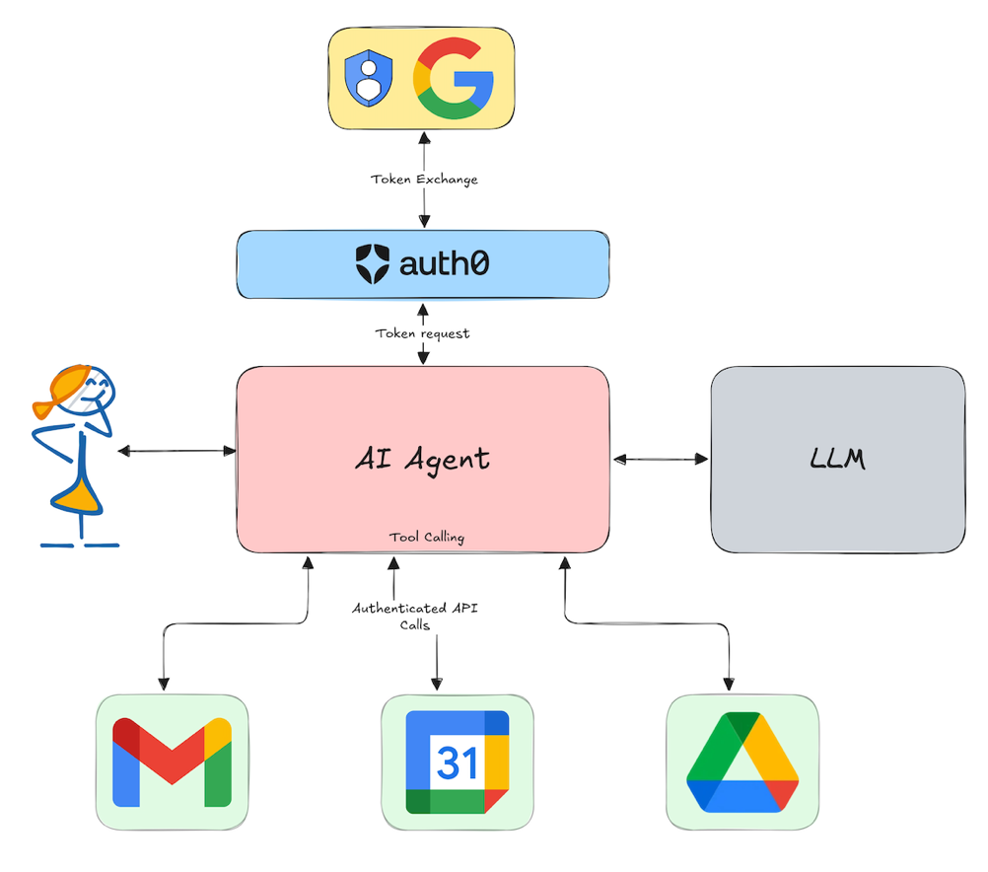
Agent need for tools
Up-to-date info (news, weather, prices)
Precision (math, database queries)
Actions (send email, create task)
Tools make agents practical

Slide 5
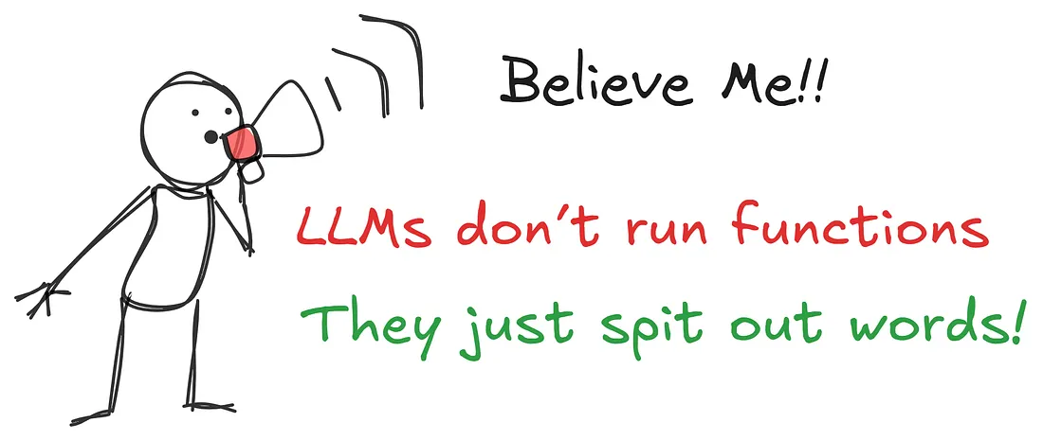
Tool Use
LLMs can’t do everything internally
Tools: search, calculator, calendar, database, custom APIs
Function Calling: model requests a tool with structured args
Result feeds back into the reasoning loop

Slide 6
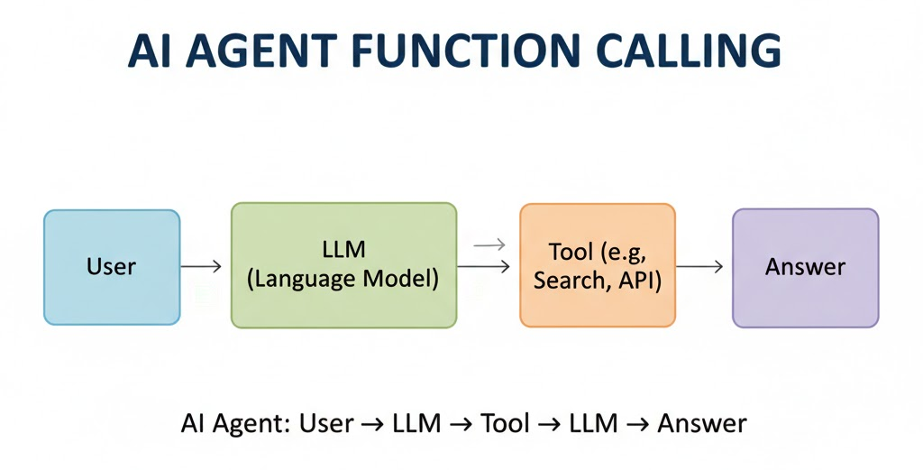
How It Works?
Define allowed functions (name, description, parameters)
Model can propose a call with arguments
Your runtime executes → returns result
Model uses result to continue reasoning

Slide 7
POST /v1/chat/completions
{
"model": "gpt-4o-mini",
"tool_choice": "auto",
"messages": [
{
"role": "system",
"content": "You are a helpful agent. If a tool can answer accurately, call that tool. Keep final answers concise."
},
{
"role": "user",
"content": "What's the weather in Tehran today?"
}
],
"tools": [
{
"type": "function",
"function": {
"name": "get_weather",
"description": "Get current weather by city name.",
"parameters": {
"type": "object",
"properties": {
"city": { "type": "string", "description": "City name, e.g., Tehran" },
"units": { "type": "string", "enum": ["metric", "imperial"], "default": "metric" }
},
"required": ["city"]
} } } ] }

Slide 8
{
"id": "cmpl_001",
"object": "chat.completion",
"choices": [
{
"index": 0,
"finish_reason": "tool_calls",
"message": {
"role": "assistant",
"content": null,
"tool_calls": [
{
"id": "call_weather_1",
"type": "function",
"function": {
"name": "get_weather",
"arguments": "{\"city\":\"Tehran\",\"units\":\"metric\"}"
}
} ] } } ]
}

Slide 9
{
"model": "gpt-4o-mini",
"messages": [
{ "role": "system", "content": "You are a helpful agent. If a tool can answer accurately, call that tool. Keep final answers concise." },
{ "role": "user", "content": "What's the weather in Tehran today?" },
{ "role": "assistant",
"tool_calls": [
{
"id":"call_weather_1",
"type":"function",
"function":{"name":"get_weather","arguments":"{\"city\":\"Tehran\",\"units\":\"metric\"}"}
}
]
},
{ "role": "tool",
"tool_call_id": "call_weather_1",
"name": "get_weather",
"content": "{\"city\":\"Tehran\",\"temp_c\":28,\"conditions\":\"Sunny\",\"observed_at\":\"2025-10-17T09:00:00Z\"}"
}
]
}

Slide 10
{
"id": "cmpl_002",
"choices": [
{
"index": 0,
"finish_reason": "stop",
"message": {
"role": "assistant",
"content": "In Tehran today it’s 28°C and sunny (observed 09:00 UTC)."
}
}
]
}

Slide 11
Designing Good Tools

Slide 12

Good Tools design
Keep schemas clear (inputs, types, constraints)
Give descriptions the model understands
Validate inputs; handle errors gracefully
Log calls for observability

Slide 13
Time To code!

Slide 14
LLM Limitations Knowledge & Hallucinations

Slide 15
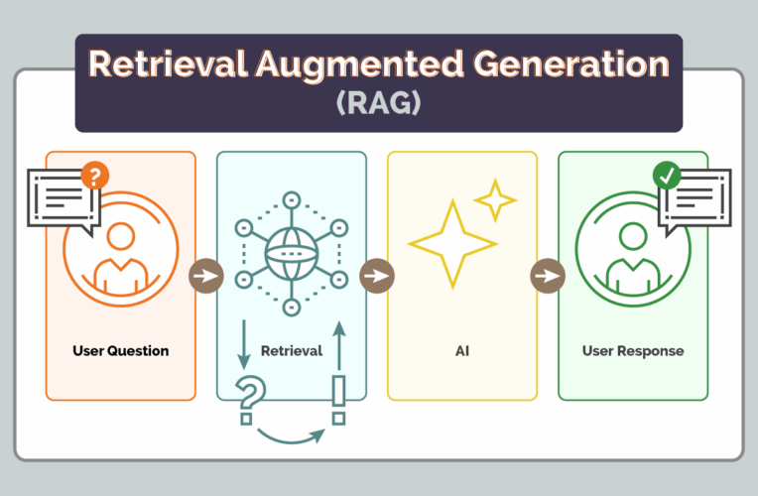
LLM Limitation
Training cutoff → old knowledge
Hallucinations → confident but wrong
We need grounding in real data

Slide 16
RAG Retrieval-Augmented Generation

Slide 17
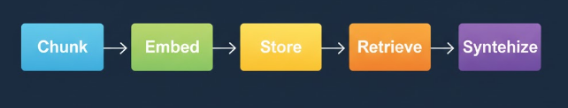
RAG pipeline
“Open-book” answer generation
Steps: Chunk → Embed → Store → Retrieve → Synthesize
Benefits: up-to-date, cited, lower hallucination

Slide 18
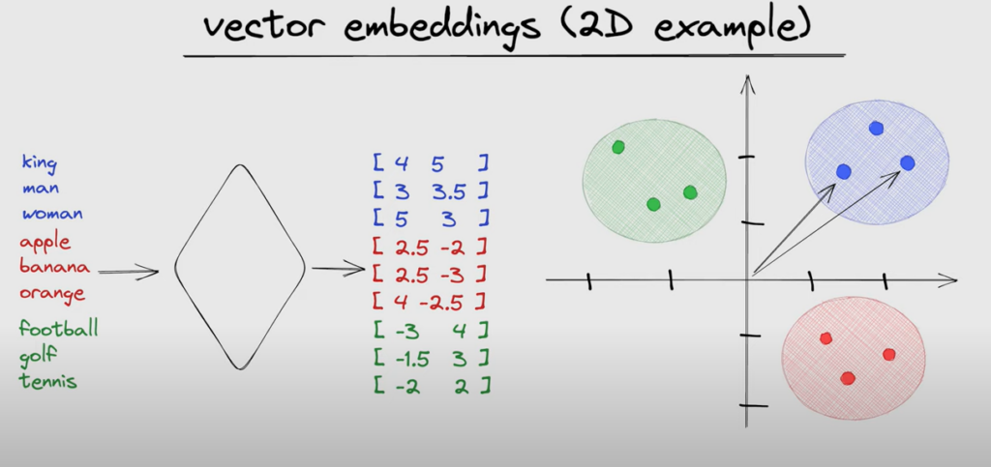
Chunking & Embeddings (English)
Chunking: split docs into manageable pieces
Embeddings: turn text into numeric meaning vectors
Similarity search: find chunks closest to the question

Slide 19
Embedding
TF-IDF (Term Frequency — inverse Document Frequency)
Computationally efficient and easy to implement.
Works well for keyword extraction and ranking.
Cannot capture the contextual meaning of words.
Sensitive to variations in phrasing and synonyms.
Unable to recognize semantic similarities.
SBERT (Sentence BERT)
Can capture semantic similarities.
Can identify synonyms effectively.
suggestion
https://hardikprakash.medium.com/comparing-tf-idf-and-sbert-for-topic-modelling-in-user-reviews-55d6f8f433d4
https://medium.com/@venugopal.adep/comparative-study-of-text-embeddings-tf-idf-vs-sentence-transformer-28627c315f21

Slide 20
Synthesis: Building the Final Answer
Provide retrieved chunks to the LLM
Prompt: “Use only these sources; cite chunk IDs”
Output: short, grounded answer + references

Slide 21
Time To code!

Slide 22
Thank you

